Slide 1
Probabilistic Modelling and Autoencoders

Slide 2
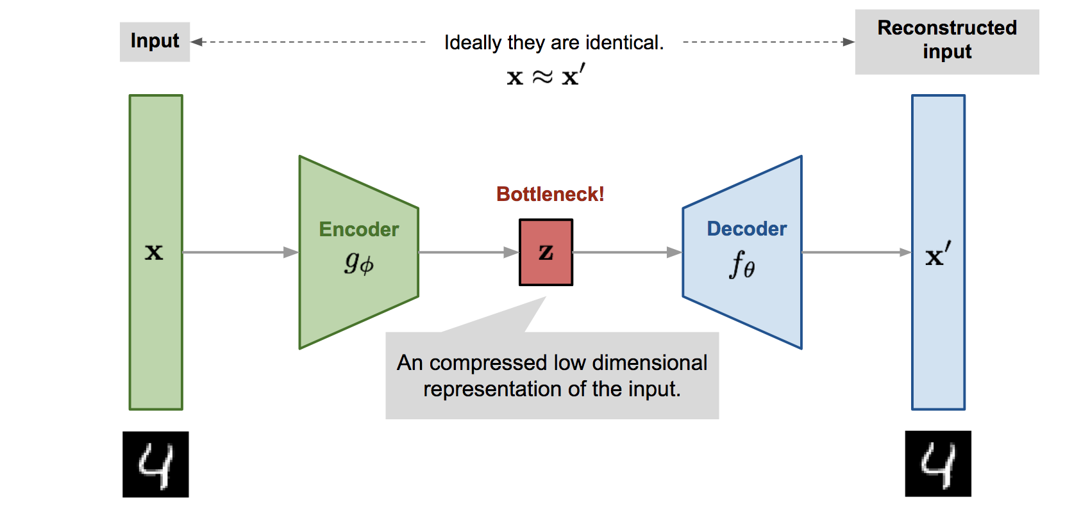
Autoencoder:

Slide 3
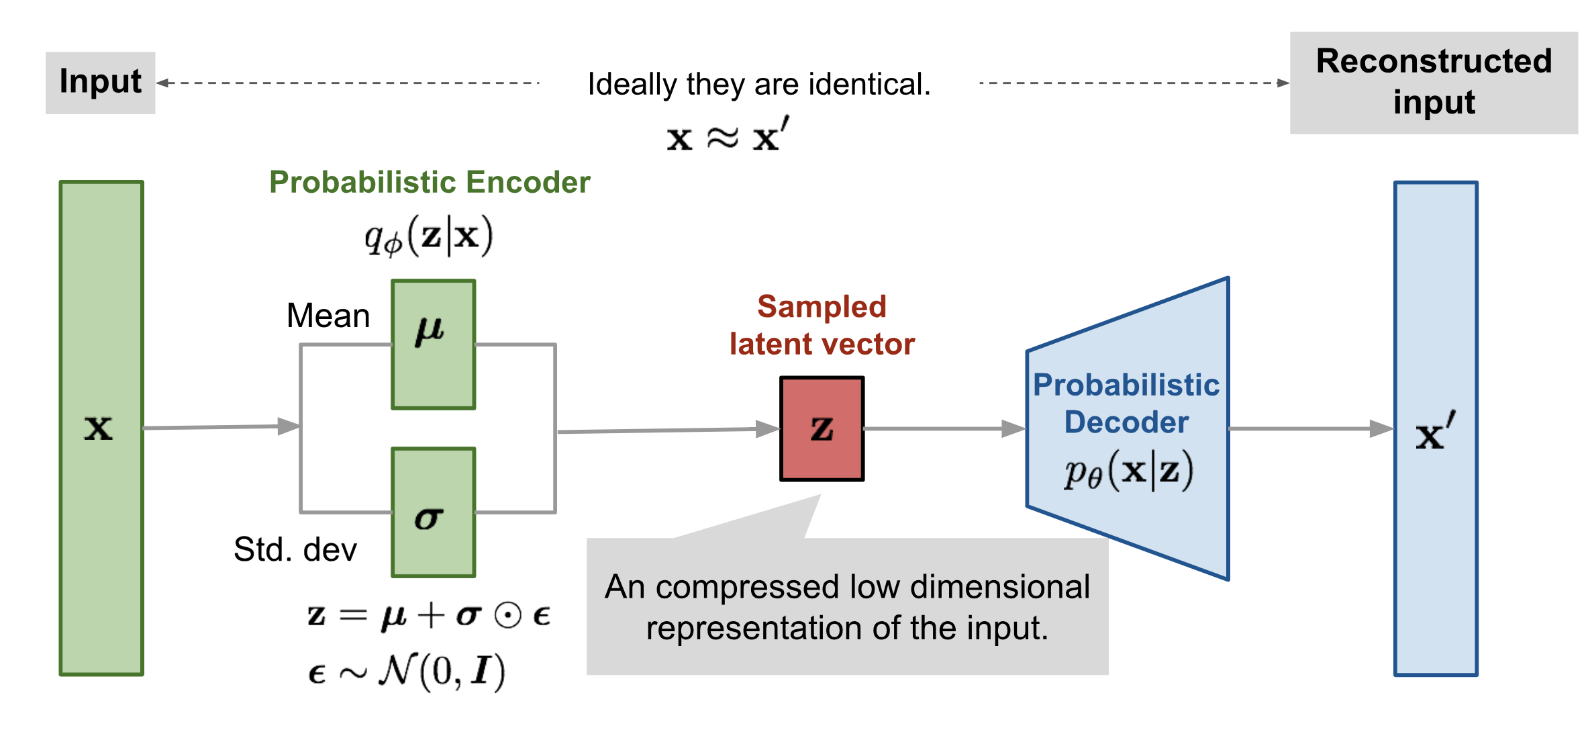
Variational Autoencoder (VAE):

Slide 4
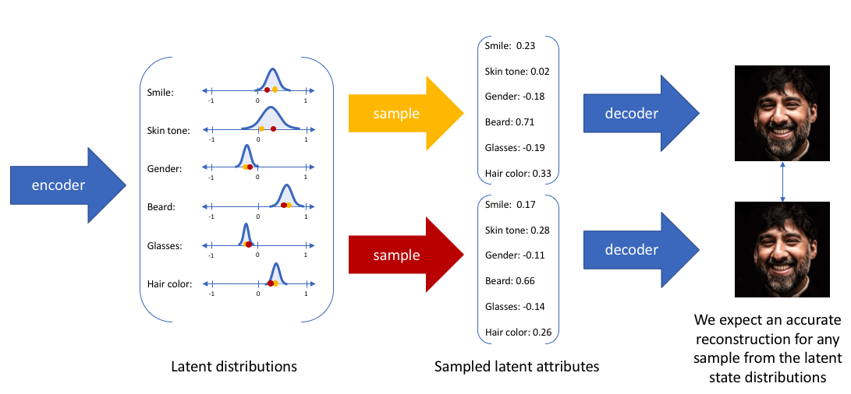
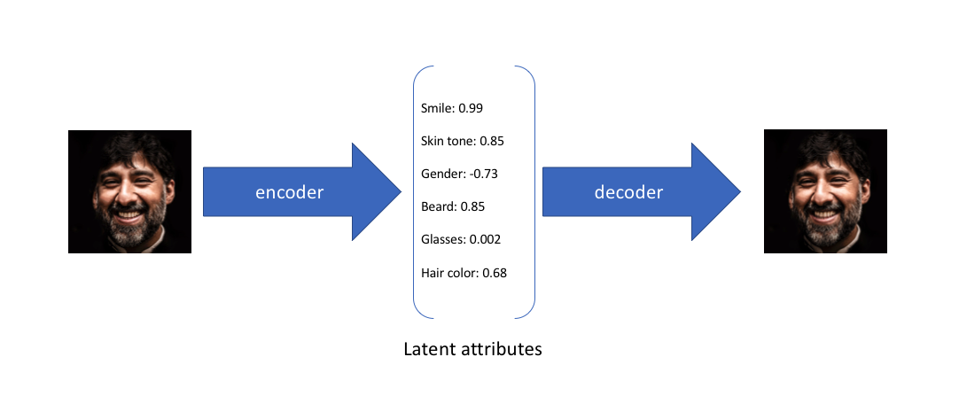
VAE
AE:

Slide 5
Reconstruction Loss:
L(θ, φ; x^{(i)} ) = −D_{KL}(q_{φ}(z |x (i) )|| p_{θ}(z)) + E_{qφ(z|x(i))} [log p_{θ}(x^{(i)} |z) ]
where,
D_{KL} is the Kullback-Leibler divergence
E_{qφ(z|x(i))} [log p_{θ}(x^{(i)} |z) ] is the log likelihood

Slide 6
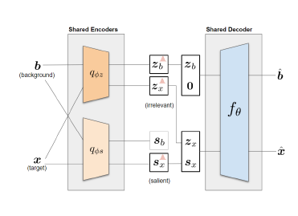
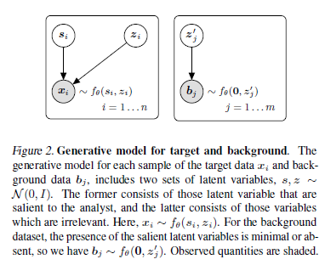
Contrastive VAE:

Slide 7


Log likelihood for target and background dataset:
For the target dataset, we have the following likelihood lower bound
For the likelihood of the background dataset, we have:

Slide 8

Correlation term:
Total correlation (TC) term is added to the objective function for the target dataset,

